Slide 1
Japanese Buddhist Hungry Ghosts— Undead Corpse Eaters
Christian Souls in Purgatory
Gaki Zoshi (Hungry Ghosts Scrolls), 12th century
Enguerrand Quarton, “The Coronation of the Virgin” 1454 CE

Slide 2
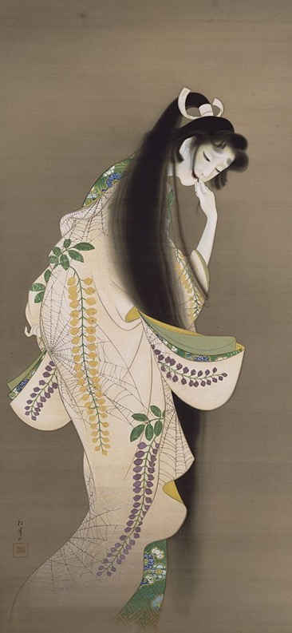
Early Ghosts: Lady Rokujo in The Tale of Genji
Written by 1021 CE by Murasaki Shikibu
Macbeth meets ghosts and witches, written by William Shakespeare, 1606
Uemura Shoen, “Flame”, 1918
Henry Fuseli, “Macbeth Consulting the Vision of the Armed Head”, 1793

Slide 3
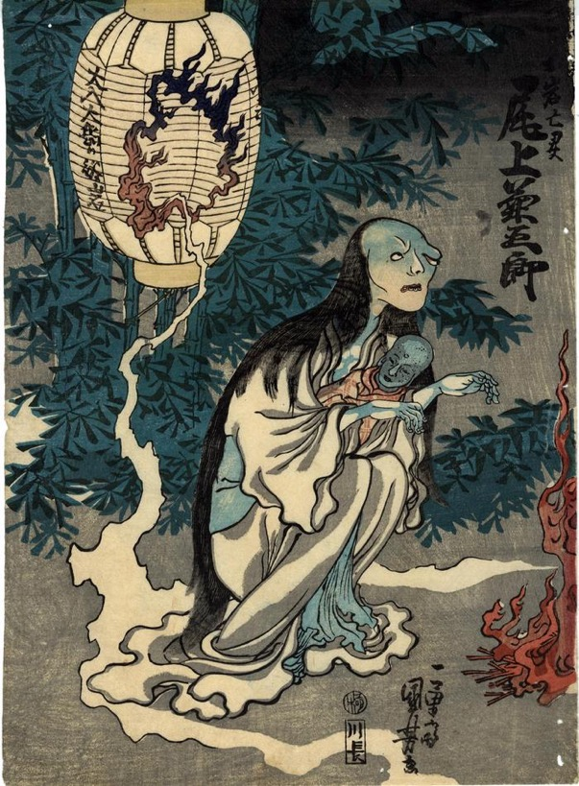
1825: The Ghost of Oiwa arrives on the scene, poisoned by her evil husband and disfigured forever
Buried body with brick in mouth
Plague Vampire Exorcism, 16th Century, Venice, Italy
Utagawa Kuniyoshi, “Onoe Kikugoro as the Ghost of Oiwa in Yotsuya Kaidan”, 1836

Slide 4
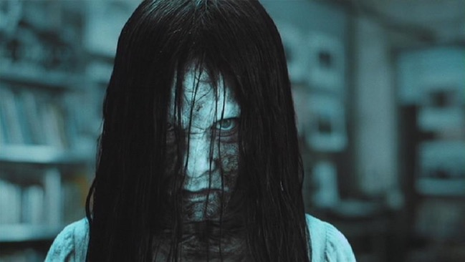
Ringu and The Ring: Cultural variations on the avenging ghost
Japan: Ringu
US: The Ring

